Slide 1
EMPLOYEE SALARY PREDICTION
CAPSTONE PROJECT
Presented By:
Student Name: PUTTA PAVAN
College Name: SR UNIVERSITY
Department: COMPUTER SCIENCE AND ENGINEERING
AICTE ID: STU64f204aa1e6e51693582506

Slide 2
OUTLINE
Problem Statement
System Development Approach
Algorithm & Deployment (Step by Step Procedure)
Result
Conclusion
Future Scope(Optional)
References

Slide 3
Problem Statement
In today’s dynamic job market, estimating fair salaries has become a challenge for both job seekers and HR professionals. Traditional methods often fall short in accounting for changing roles, locations, and experience levels, leading to inaccurate salary expectations.
This mismatch can result in job offer rejections, talent loss, or budget issues. Key factors like education, experience, job title, and location make manual salary estimation inefficient and inconsistent.
To address this, the project aims to build a machine learning-based application that predicts employee salaries accurately. This tool will help align expectations, support fair pay decisions, and improve hiring efficiency.

Slide 4
System Approach
The Employee Salary Prediction System was designed in a simple and flexible way. It uses clean data, machine learning models, and a smooth process to give accurate salary predictions in real time.
System requirements
Python 3.10+, Google Colab, VS Code
Git & GitHub for version control
Streamlit Community Cloud for deployment
Libraries Used
Data Handling: Numpy, Pandas, Scikit-learn
ML Models: Linear Regression, Logistic Regression, Decision Tree.
Visualization: matplotlib, seaborn
Web App: Streamlit

Slide 5
Algorithm & Deployment
Algorithm Workflow
1. Data Loading & Cleaning
- Loading the dataset using Pandas Library
- Handling missing values and removing duplicate records
- Renaming and selecting only the required columns for analysis
2. Exploratory Data Analysis
- Creating charts for categorical features like gender and degree
- Checking correlation between age, experience, and salary
- Plotting a heatmap to visualize feature relationships
3.. Data Loading & Cleaning
- Encoding categorical columns like Gender, Degree, and Job Title
- Scaling numerical features such as Age and Experience
- Splitting the data into training and testing sets for modeling

Slide 6
Algorithm & Deployment
4. Model Training & Evaluation
- Training models: Linear Regression, Logistic Regression, Decision Tree, Random Forest
- Evaluation metrices used:R² score, RMSE, MAE
- Comparing model results to choose the most accurate one
5.Deployment Preparation
- Saving the best model using joblib for reuse
- Creating a prediction pipeline for easy integration
- Deployed the application using Streamlit web framework

Slide 7
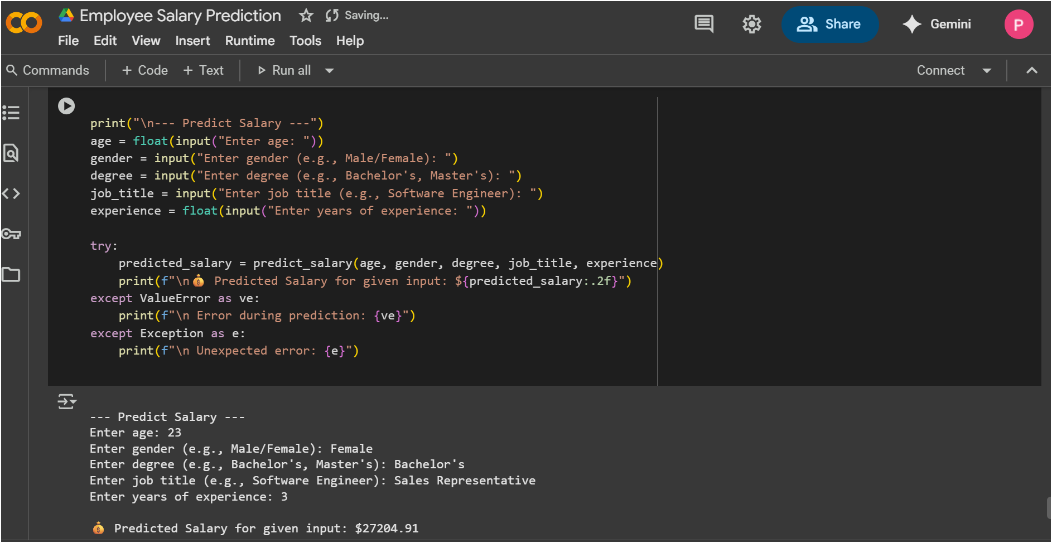
Result

Slide 8
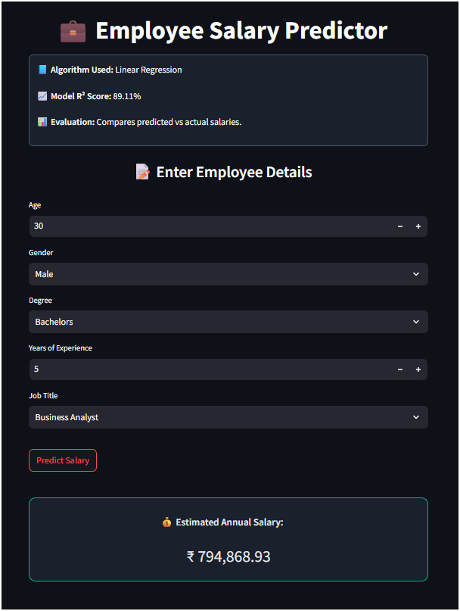
Result

Slide 9
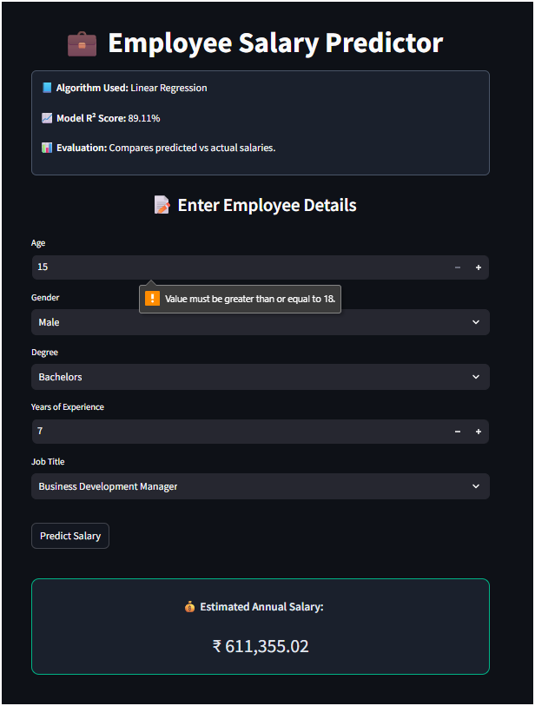
Result

Slide 10
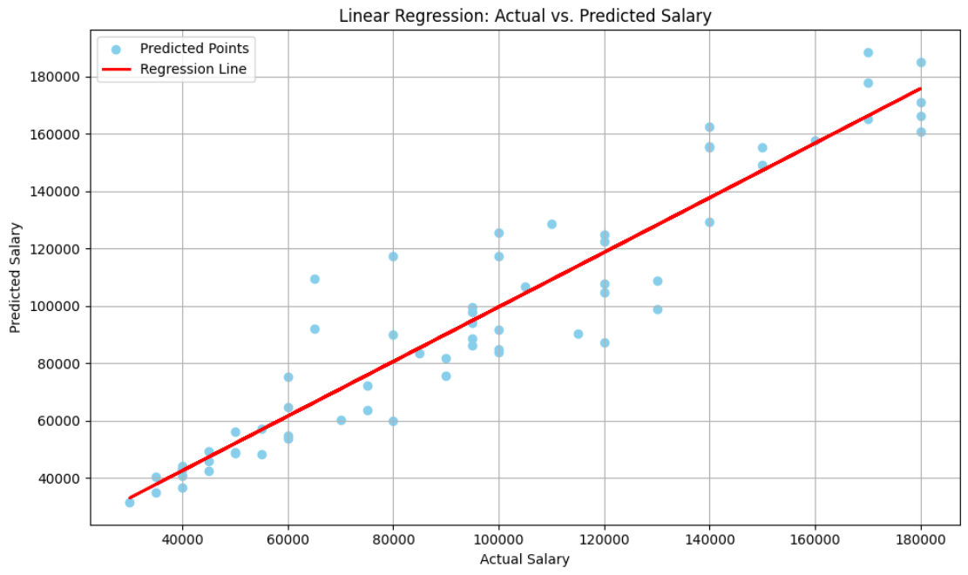
Result

Slide 11
Result
Github Repository Link :
https://github.com/PavanPutta14/Employee_Salary_Prediction
Live App Link:
https://employee-salary-prediction-machine-learning.streamlit.app/

Slide 12
Conclusion
This project demonstrates the real-world potential of machine learning in automating complex decision-making processes like salary estimation, saving time and resources across industries.
It shows how AI-powered prediction systems can bring fairness, consistency, and data-driven insights to various domains such as workforce analytics, career advisory platforms, and financial planning.
The solution proves that machine learning models can be effectively deployed in user-facing web applications to solve practical problems — helping businesses, job portals, and professionals make informed compensation-related decisions.

Slide 13
Future scope(Optional)
Integration with Real-Time Job Market Data: The model can be enhanced by integrating live job market data (e.g., from LinkedIn, Glassdoor APIs) to reflect current salary trends and regional variations more accurately.
Expansion to Multiple Domains: Beyond traditional jobs, the system can be extended to predict earnings in freelancing, startups, gig economy roles, and remote work environments, making it more versatile.
Personalized Career & Salary Recommendations: With additional user data (skills, certifications, career goals), the system can evolve into a smart advisor — recommending salary-boosting career paths, roles, or upskilling options.

Slide 14
References
IJSRCSEIT. (2020) – Machine Learning Approach for Employee Salary Prediction (Applied ML models for salary prediction using employee datasets)
Kaggle Dataset – Data Science Job Salaries (Used for salary prediction based on experience, title, and company factors) https://www.kaggle.com/datasets/ruchi798/data-science-job-salaries
Kiattisak, R. (2022) – Salary Prediction for Beginner Available at: https://www.kaggle.com/datasets/rkiattisak/salaly-prediction-for-beginer (Used for training and evaluating machine learning models on salary prediction)
▪ Kaggle Dataset – HR Analytics Job Salaries (Real-world HR dataset suitable for salary prediction tasks) https://www.kaggle.com/datasets/arashnic/hr-analytics-job-salaries

Slide 15
THANK YOU

